Slide 1
Signing and Markings for Complex Freeway Interchanges
Duane Thomas, P.E.
FHWA Resource Center and MUTCD Team
ACEC/KYTC/FHWA Partnering Conference
September 5, 2018

Slide 2
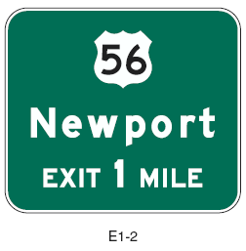
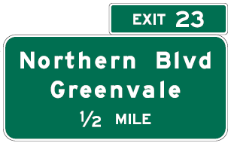
Conventional Group
Type - Advance Guide (AG)
  Shows place and/or route name
  Route number (if applicable)
  Typical advance placement distances
    2, 1, ½ mile
Use White/Grn “EXIT” only once per sign
Notes:
Key Message: AG can be thought of as any sign which gives advance notice of the route and destination information in Advance of the exit. Distances should be shown unless a lane drop further upstream than ½ mile.
Note that the EXIT action word is used on the upper design (Newport) for routes where exits are not numbered. (See ¶8 of 2E.33). IF exits are numbered, the EXIT panel would be used on the top to the side of the exit (L or R) with the number (23) as shown in the lower design (Northern Blvd)
Key check is to see if EXIT appears twice on the sign plan detail sheets.
Suggested Comments: Exception to rule is black on yellow legend “EXIT” may also appear. Many designs and shapes. Remember conventional include drop signing designs. IF the exit is to the left the LEFT panels or overlays are required.
Suggested Questions:
Additional Information:

Slide 3
Conventional Group
Type – Exit Direction (ED)
  Same info as AG
  Indicates point of divergence from mainline
  Placement
    Post mounted at
      begin decel lane
    Overhead at theoretical gore, physical gore, or pt. of divergence
Notes:
Key Message: Exit Direction must be mounted overhead if a lane drop. If less than 300 ft from begin taper to gore, mount at the gore location
Suggested Comments: Many designs and shapes. If less than 300 ft from begin decel to gore, signs which would otherwise be post mounted should be installed OVH at the theoretical gore.
Suggested Questions:
Additional Information:

Slide 4
Gore Sign
  Indicates point of departure at physical gore
  Consistent placement vital
Notes:
Key Message: Shows point of roadway departure, marks physical gore
Suggested Comments:
Suggested Questions:
Additional Information: Pull-thru signs are another common sign but is not considered part of pre-interchange signing. Pull- thru signs will be covered in Module #5 “Challenges..” because they can create some challenges on when to use, how to design, and where to place.

Slide 5
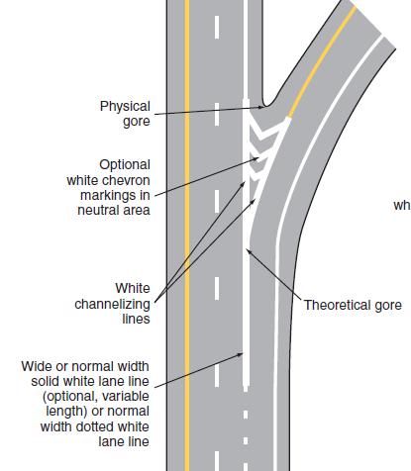
Physical Gore vs Theoretical Gore

Slide 6
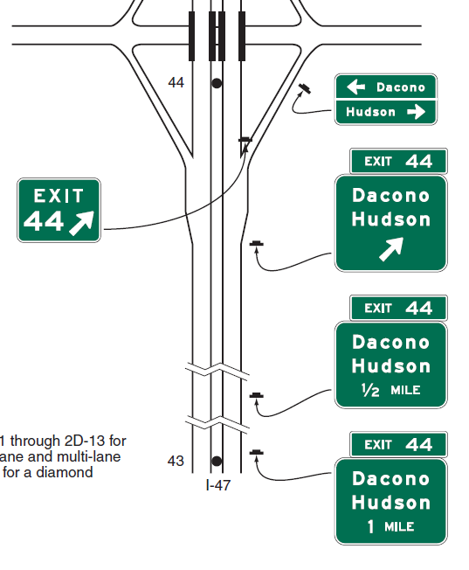
Fig. 2E-38
Conventional Group
*No Lane Drops
Gore
Exit Direction (ED)
* Tapered or Parallel Developed Aux Lanes
Advance Guide (AG)
Advance Guide (AG)
Notes:
Partial image of Page 233 MUTCD Part 2E Fig __2E-38__

Slide 7
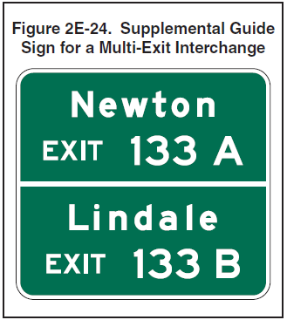
Supplemental Guide Signs
One supplemental sign each direction
Two Destinations per sign maximum
Brown and Green (does not include Blue)
State Policy/AASHTO Guide

Slide 8
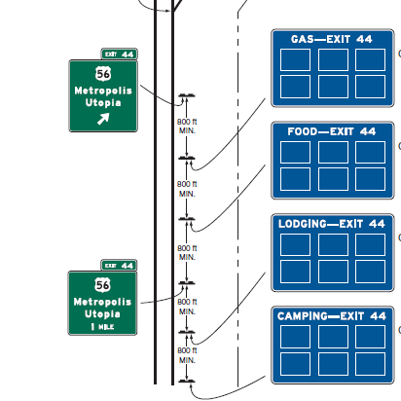
Sign Spacing – 800 feet minimum

Slide 9
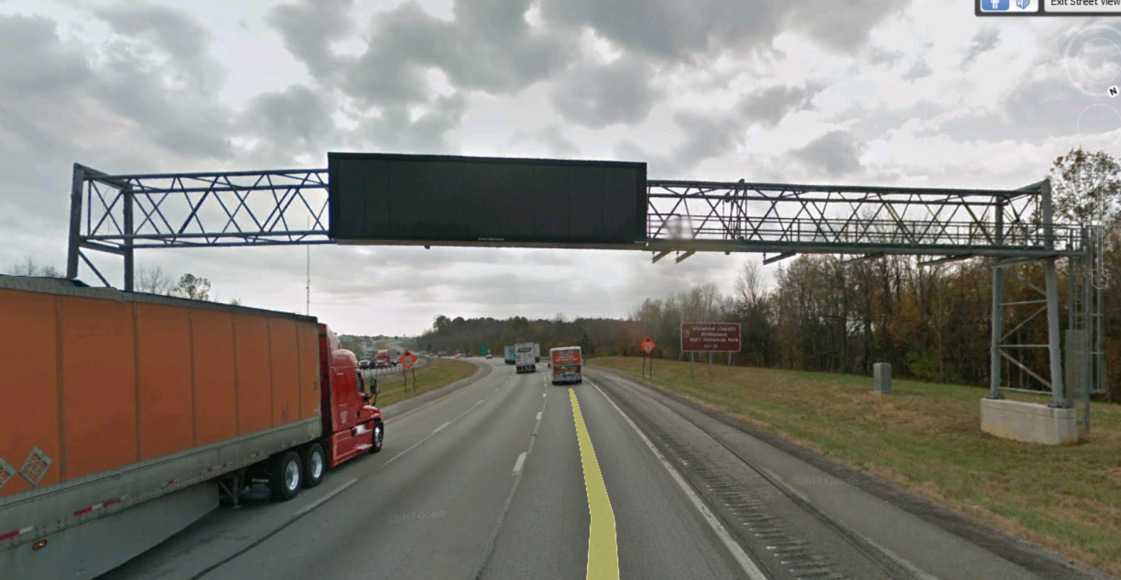
Spacing Requirement also applies to
Overhead Dynamic Message Signs

Slide 10
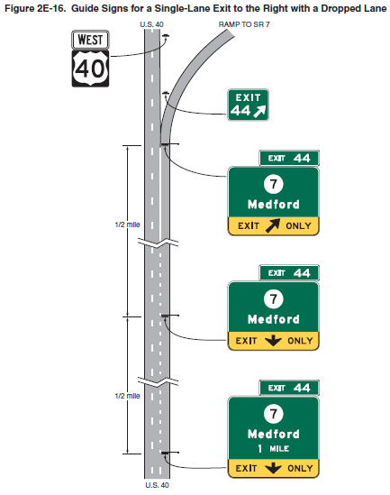
Conventional Group
Lane Drop Layout
  Requires overhead installation
  Requires EXIT ONLY panel
  Same info as traditional AG & ED layouts
Gore
ED
AG
AG
Notes:
Key Message: Exit Direction must be mounted overhead if a lane drop. If less than 300 ft from begin taper to gore, mount at the gore location
Suggested Comments: Many designs and shapes. If less than 300 ft from begin decel to gore, signs which would otherwise be post mounted should be installed OVH at the theoretical gore.
Suggested Questions:
Additional Information:

Slide 11
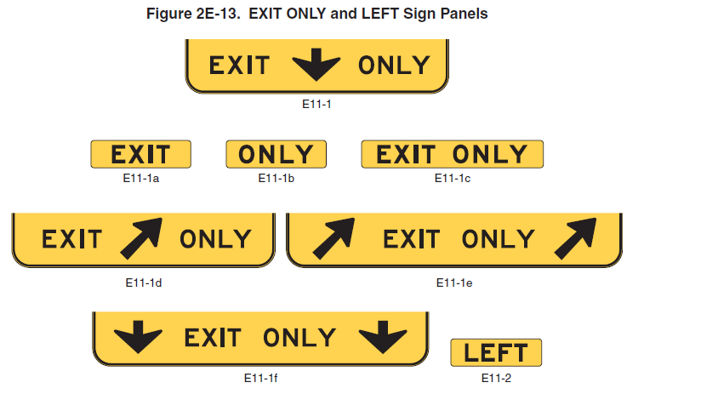
MUTCD Figure 2E-13
Overlay Panels are an Option allowed to retrofit existing signs
Notes:
Key Message: Retrofit Option applies to ED and AG signs. New “LEFT” panels are required for all exits to left, either as an overlay, or part of the EXIT panel …next slide
Suggested Comments:
Suggested Questions:
Additional Information:

Slide 12
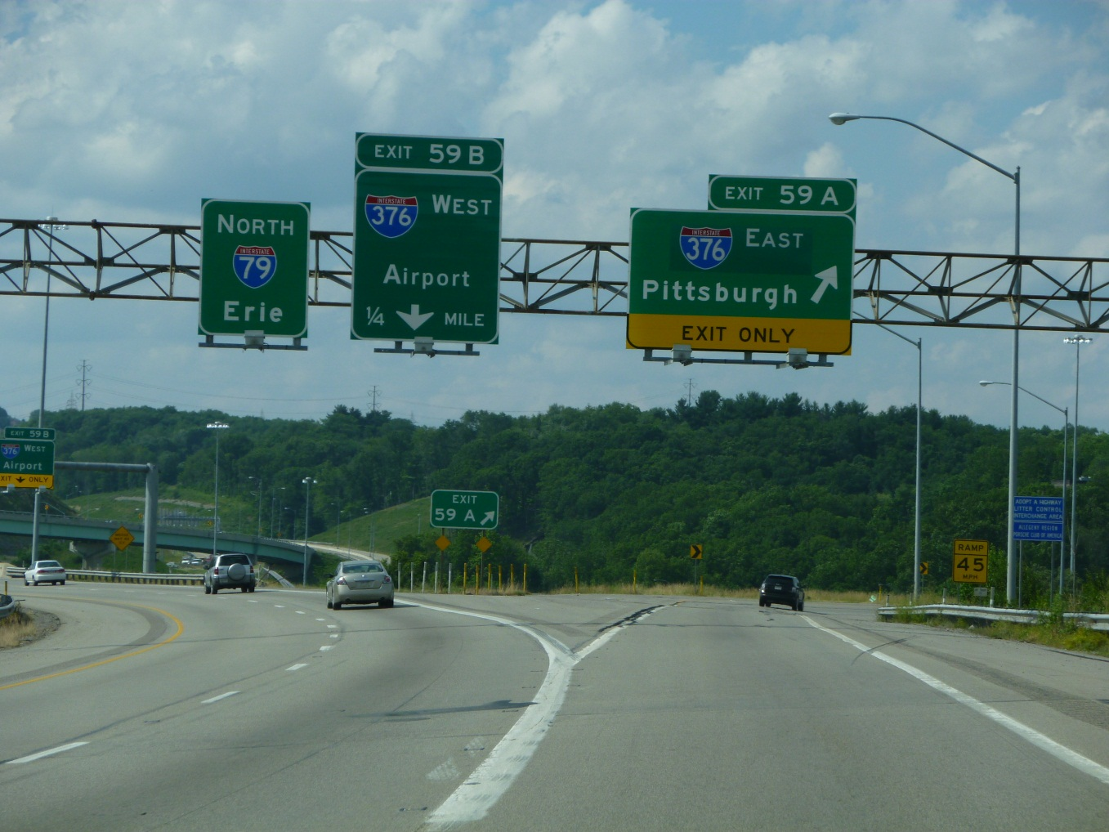
The 2 Purposes of Arrows
To indicate direction towards routes or destinations-upward slanting arrow (rightmost sign)
To provide lane assignment information- down arrow
(middle sign)
Notes:
Key Message: This photo illustrates the two purposes and the two correct types of arrows. (Type A and the down arrow).
Suggested Comments: This applies to guide sign conventional type. Loop arrows for geometry, diagrammatic, APL, etc. are exceptions to the ruleI-376 West down arrow provides lane assignment information; I-376 East, upward slanting arrow indicates the direction of movement at the theoretical gore for Pittsburgh (destination) and I-376 East (route)
Suggested Questions:
Additional Information: Research use of circular or loop arrows
Design size of arrows based upon UC letter height of principal legend
Later, we’ll identify what types of guide signs and geometric conditions require, recommend or permit the use of arrows and how they are located on the signs in relation to the geometrics of the roadway (Ex. Exit direction signs-Placement typically left for left exit, right for right…may be placed underneath for especially wide signs)

Slide 13

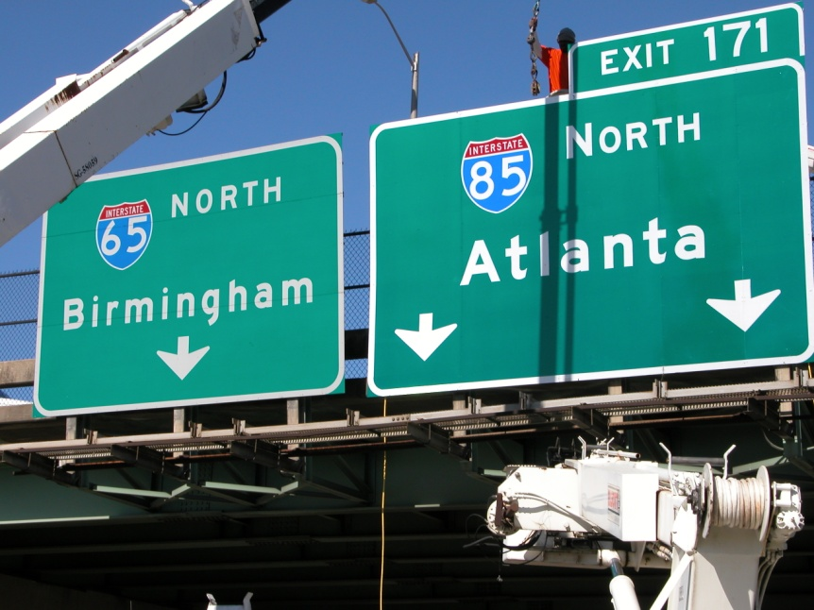
Down Arrows-Interchange Guide Signs
MUTCD Standards
  For overhead guide signs only
  Where lane use is restricted
  Must be centered over lane
  Must point downward
  Two arrows cannot point to same lane
Notes:
Key Message: Restrictions on the use of the down arrrow.
Suggested Comments:
Suggested Questions:
1)What problems have you encountered or seen with use of down arrows? As a driver or as a designer or other engineer?
Possible answers: two arrows pointing to same lane, arrow not near center of lane (off-centered), due to roadway curvature or exit curvature it is unclear which lane the arrow is pointing to, crowding of letters and borders where down arrows are used.
2) IS it Ever desirable to get folks into the proper lane for a turn or exit even though it may not be “exclusive or restricted?” Where is this situation covered in the MUTCD?
3) Do you see a conflict with these Standards in 2E.19 and the Guidance provided on the use of the down arrow in 2E.12?
Additional Information:

Slide 14

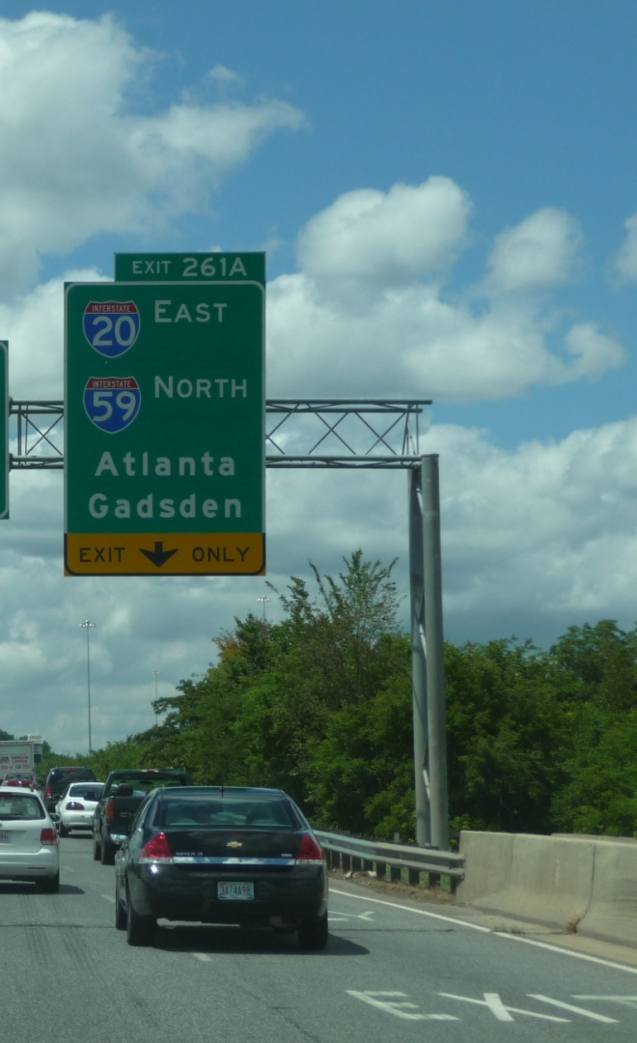
Black Arrows on Yellow (Y/B)
Must Use Y/B Down arrow(s):
  AG location for any lane drop
  ED location for a straight two lane exit where through lane curves
  AG & ED locations for Split with dedicated lanes
Notes:
Key Message: Warning panels are required at particular locations for certain exit lane configurations and direction of primary route in relation to the exit (example: through route curve and exit straight). Down arrows may be used at both the ED and AG locations
Suggested Comments:
Suggested Questions:
Additional Information:

Slide 15

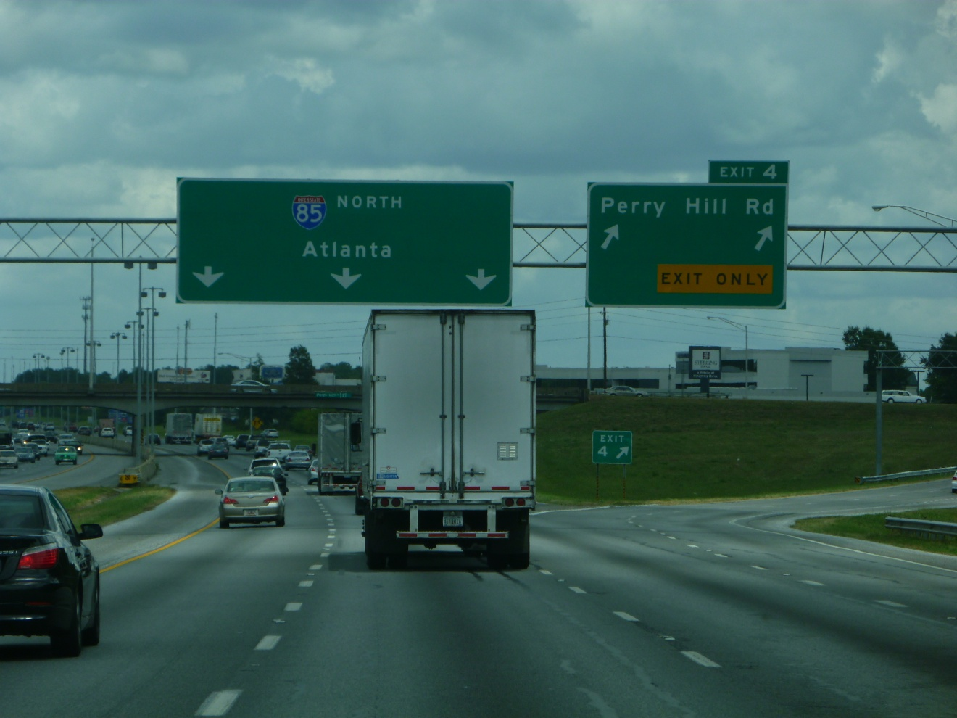
Down Arrows on Pull-Throughs
2E.12
Alignment of thru lanes is curved and exit direction is straight
Number of thru lanes not apparent and
At multilane exits where # of thru lanes is reduced
Notes:
Key Message: Arrows on Pull-Throughs are not required. The three conditions should be met before their use (MUTCD Guidance=should condition). Many of the down arrows one finds on Pull-Throughs are not necessary and add to the number of message sets and information the driver must process. Generally, Pull-through signs should not have arrows… only after careful consideration and satisfaction of the three point test and the advance viewing test should they be given further consideration.
But remember, pull-throughs should meet specific criteria for their use. Then if determined they are needed, consider whether criteria is met for the use of the down arrow.
Suggested Comments: Do savings exist with this design installation?
Suggested Questions: Where should these signs be installed? At the gore? Recall the basic concept of only the ED sign at the gore vicinity.
Moreover, are Pull-Throughs needed here? Would any driver, knowing what route they are on, be able to deduce they are still on this route once they pass the exit gore moving straight ahead? Are we promoting information overload for the driver?
Additional Information: 2E.12 in the 2009 Edition may have intended to be an OR and not “and.”
Which raises the question: Does the use of a down arrow on a pull-through sign weaken the standard of only using the down arrow on restricted lane.
An example of this situation will arise in Group Exercise for the interior option lane from I-85 SB to I-65 NB. Should a down arrow be used under “Birmingham?”

Slide 16
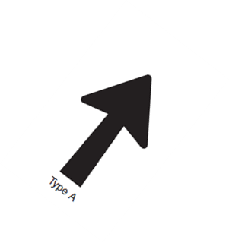
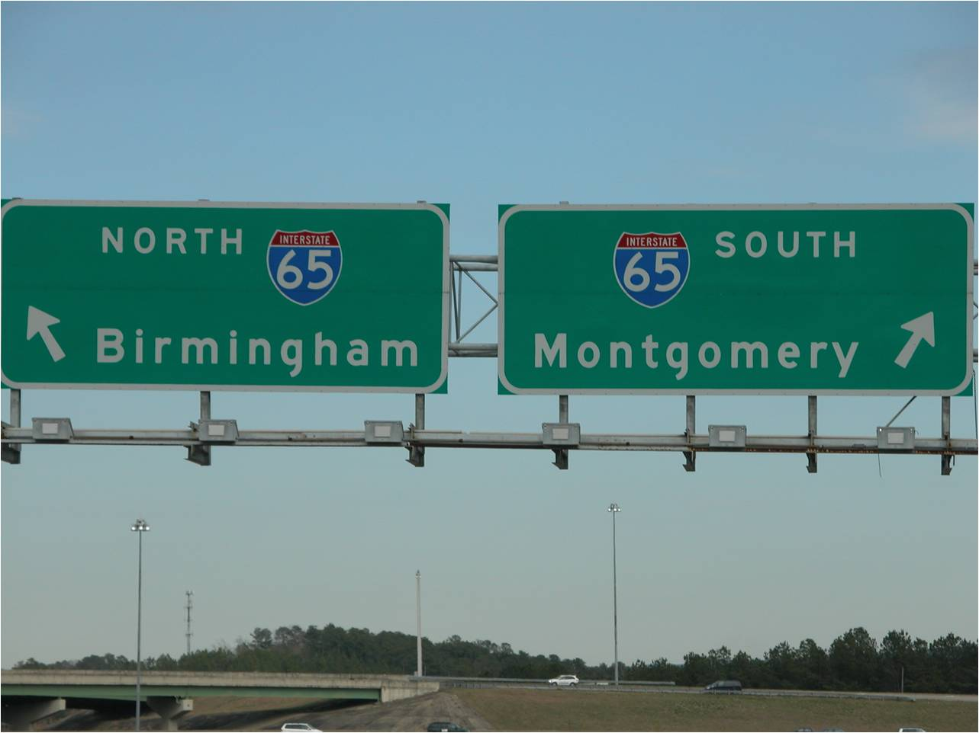
Upward Slanting Arrows - General
To side of the exit
  (If post mounted & wide sign, may be under legend)
Below the legend on multi-lane exits
Positioned over lane to which it applies
@ All ED signs EXCEPT APL & Lane drop
Notes:
Key Message: Arrow may be positioned to the right or beneath the legend depending on space limitations and resulting width of sign if too large (when positioned to right of legend)
Suggested Comments:
Suggested Questions:
Additional Information:

Slide 17
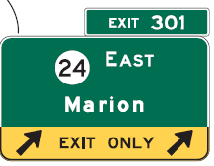
Black Arrows on Yellow (Y/B)
Must Use Upward Slanting Y/B @ ED location for:
  Two lane exit with option lane
  Split with Option lane
  Drop lane with Option lane
  Single Drop lane
  Splits with dedicated lane
Notes:
Key Message: Upward slanting arrows are only used at the ED locations
Suggested Comments: Point out again that these locations are where the black on yellow arrows are required. Exceptions are rare for the intermediate and minor interchange classes. Other locations may use the white on green.
Suggested Questions: What is the difference in terms of placement variability between upward and downward yellow arrows?
Answer: Upward slanting yellow arrow is only used at the ED location.
Additional Information:

Slide 18
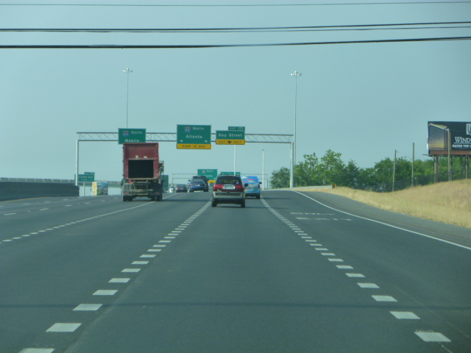
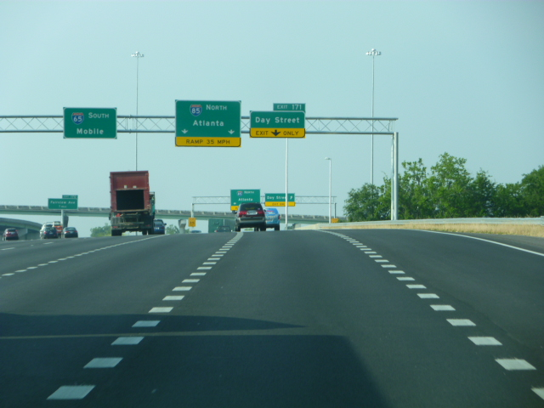
Example: Problematic Placement and Design
Down Arrows in a Horizontal Curve
x
x
700 ft
350 ft
Notes:
Key Message: At 650 ft. out the driver in the second lane from the right shoulder appears to be in the lane for Day St. The same is true at the 300 ft. distance
Suggested Comments:
Suggested Questions:
Additional Information: Blue lines in ppt are centered over arrows and show the arrows appear centered over the second from right lane.

Slide 19
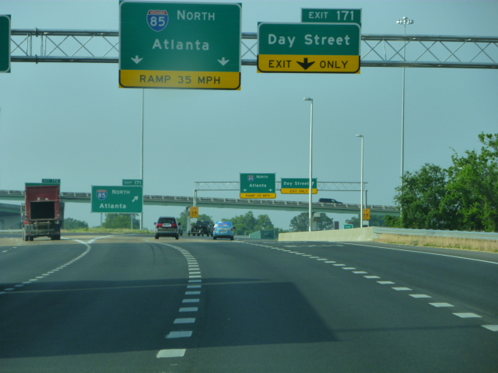
Example: Problematic Placement and Design
Down Arrows in a Horizontal Curve
x
125 ft
Notes:
Key Message: Although at 125 ft one can see the structure is placed in a curve and the second lane is actually for the outside lane of the two lane exit for 85 North Atlanta. Vertical blue line is attempted to show centerline of arrow.
Suggested Comments: The placement of this sign structure could certainly have been at a better location for the motorist.
Suggested Questions: Are HF needs satisfied with this sign design and placement location to convey a clear, simple message to the motorist?
Additional Information: When might this design decision been handled differently or corrected?

Slide 20
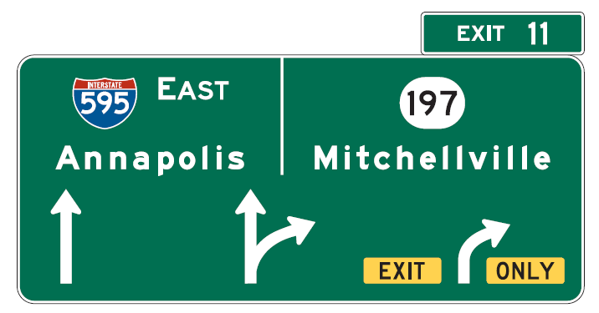
Diagrammatic Group
Multilane exits where option lane is present
Used for splits where option lane is present
Two alternate layouts
Arrow per lane layout
Traditional layout
Notes:
Key Message: APL designs are new for 2009 and have been validated for effectiveness over other designs tested. Note shared arrow shaft in center splitting into two arrowheads. Remember, an option lane must be present for their use.
Suggested Comments: APL design is used at the ED location, whereas older diagrammatic uses convention designs at ED location
Suggested Questions:
Additional Information: Research comes from pooled fund study, Evaluation of Diagrammatic Freeway Guide Signs, May 2008 Katz and Golembiewski. Study limited in designs and lane configurations examined. Google Pooled Fund Study website. Report group TPF-05, #65.

Slide 21
Diagrammatic Group
Arrow Per Lane (APL)
Interchange class:
  Major – required
  Intermediate-recommended
Used for both AG and ED locations
Notes:
Key Message: APL designs are new for 2009 and have been validated for effectiveness over other designs tested. Note shared arrow shaft in center splitting into two arrowheads. Remember, an option lane must be present for their use.
Suggested Comments: APL design is used at the ED location, whereas older diagrammatic uses convention designs at ED location
Suggested Questions:
Additional Information: Research comes from pooled fund study, Evaluation of Diagrammatic Freeway Guide Signs, May 2008 Katz and Golembiewski. Study limited in designs and lane configurations examined. Google Pooled Fund Study website. Report group TPF-05, #65.

Slide 22
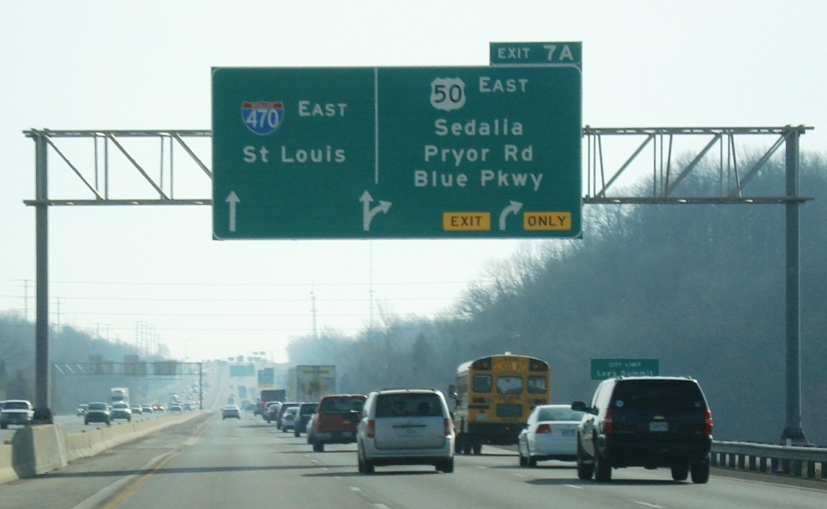
MUTCD Interchange Classification
2E.32
MAJOR
Interchanges with other freeways, expressways, or high-volume multi-lane highways (arterials or major rural routes) where the volume of interchanging traffic is heavy or includes many road users unfamiliar with the area
Photo Credit: Mark Doctor, FHWA
Notes:
Key Message: traffic control device selection and design is dependent on several factors which may or may not be readily apparent to the TCD designer.
Suggested Comments:
Suggested Questions:
Additional Information:
Class: defined in the MUTCD. Some slight flexibility exist to rate an interchange as one of the three. Such as how is the connecting route classified functionally, is the function current? Are other routes served there?
Context: how does this interchange fit in with the surrounding and adjoining interchanges, what type signing is presently in use? Is it presently conforming or non-conforming to standards?
Type: 5 General types per AASHTO Green book, P 776, 2004 Ed. Par Clo stands for Partial Cloverleaf

Slide 23
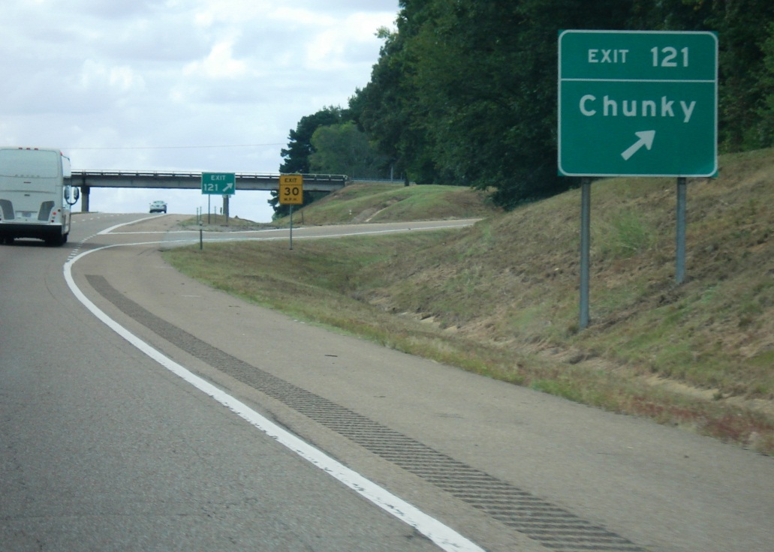
MUTCD Interchange Classification
2E.32
MINOR
Interchanges where traffic is local and very light
Sum of exit volumes is estimated to be < 100 vehicles per day in design year
Photo Credit: Mark Doctor, FHWA
Notes:
Key Message: traffic control device selection and design is dependent on several factors which may or may not be readily apparent to the TCD designer.
Suggested Comments:
Suggested Questions:
Additional Information:
Class: defined in the MUTCD. Some slight flexibility exist to rate an interchange as one of the three. Such as how is the connecting route classified functionally, is the function current? Are other routes served there?
Context: how does this interchange fit in with the surrounding and adjoining interchanges, what type signing is presently in use? Is it presently conforming or non-conforming to standards?
Type: 5 General types per AASHTO Green book, P 776, 2004 Ed. Par Clo stands for Partial Cloverleaf

Slide 24
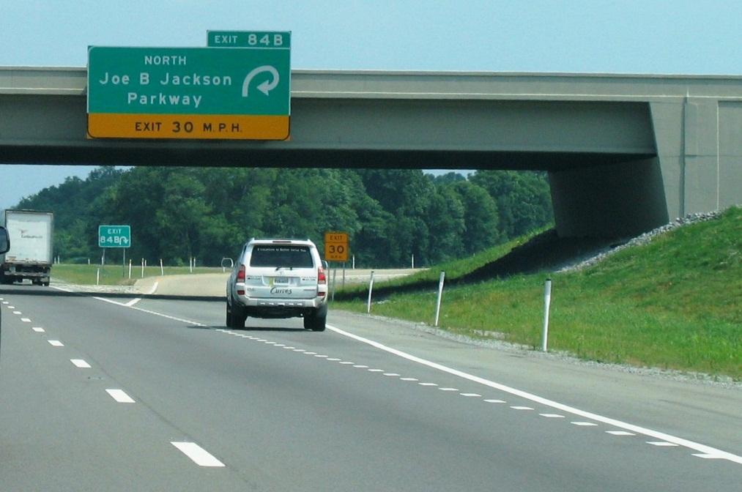
MUTCD Interchange Classification
2E.32
INTERMEDIATE
Interchanges with urban and rural routes not in the category of major or minor
Photo Credit: Mark Doctor, FHWA
Notes:
Key Message: Biggest class of interchanges
Suggested Comments:
Suggested Questions:
Additional Information:
Class: defined in the MUTCD. Some slight flexibility exist to rate an interchange as one of the three. Such as how is the connecting route classified functionally, is the function current? Are other routes served there?
Context: how does this interchange fit in with the surrounding and adjoining interchanges, what type signing is presently in use? Is it presently conforming or non-conforming to standards?
Type: 5 General types per AASHTO Green book, P 776, 2004 Ed. Par Clo stands for Partial Cloverleaf

Slide 25
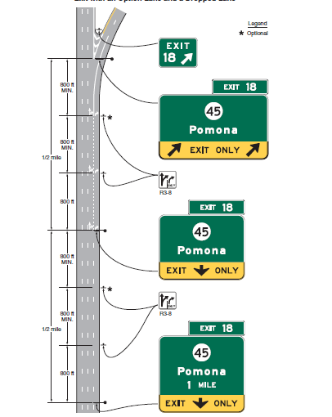

If not using APL
with an option lane…

Slide 26
When to Implement APL???
“Overhead Arrow-per-Lane guide signs shall be used on all new or reconstructed freeways and Expressways…”
Option:
“At existing or non-reconstructed locations where Exit Direction and Pull-Through signs exist at the theoretical gore, the existing sign support structure may remain in place, continuing to use Exit Direction and Pull-Through signs, in conjunction with a replacement of the advance signs using the Overhead Arrow-per-Lane guide sign design.”
“The Overhead Arrow-per-Lane guide sign at the exit shall not be located at or near the theoretical gore.”

Slide 27
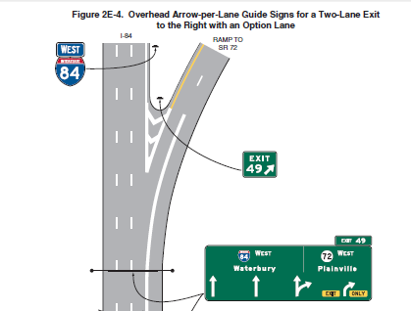
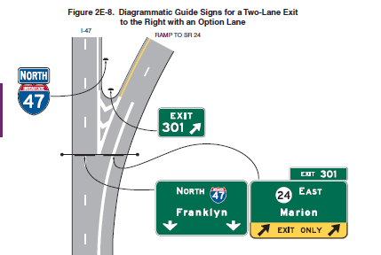
Exit Direction Truss Location

Slide 28
Interpretation Letter 2(09)-5(I)
widening or reconfiguration of the travel lanes
if the existing sign support structure is to remain

Slide 29
Diagrammatic Group
Traditional
Interchange class:
  Major – required
  Intermediate-recommended
Show representation of exit arrangement relating to mainline
Arrowheads required; point to shield for off movement
Limit of 2 destinations/routes
Use only as AG sign location
Notes:
Key Message: Older version of plan view of lane movements. Arrowheads should point to route shields. Newer type of diagrammatic are the Arrow per lane (APL)
Suggested Comments: Diagrammatic are not used at the ED location, conventional are used; Mileage may be used if over 1 mile.
Suggested Questions: Would it be difficult to detect the number of lanes exiting or the lane positioning on this type of sign at the advance viewing distance?
Additional Information:

Slide 30

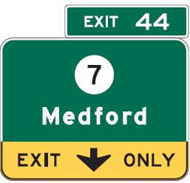
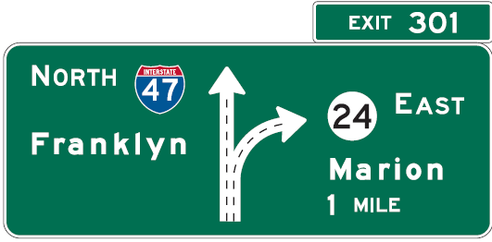
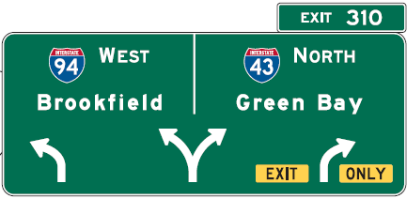

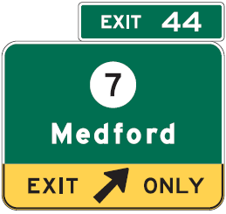
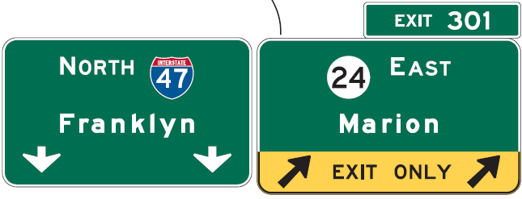
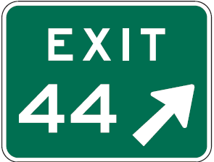
Sign Type | Sign Design Group
 | Conventional |  | Diagrammatic
 | Traditional- Deceleration Lane | Drop | a -Traditional | b - Arrow Per Lane
Advance Guide
Exit Direction
 |  | See 2E.19 and 2E.22 Ᵽ2. Exit arrows are down for straight exits where through route is curved; Exit arrows are upward slanting where exit is curved and through routes are straight. * This sign is considered a pull through type sign
Gore | Arrow always upward slanting
Table of Typical Sign Design Layout by Group and Type
(Graphic Version) (Table 3c)
*
Notes:
Key Message: Traditional Diagrammatic note: If the Thru route is curved, arrows are upward slanting & exit arrows are downward pointing; if Thru route is straight, arrows are downward pointing & exit arrows are upward slanting. Where a split is present w/o an exit , the EXIT ONLY panel is not used.
Suggested Comments:
Suggested Questions:
Additional Information:
[PW Note: Print full page landscape view]

Slide 31
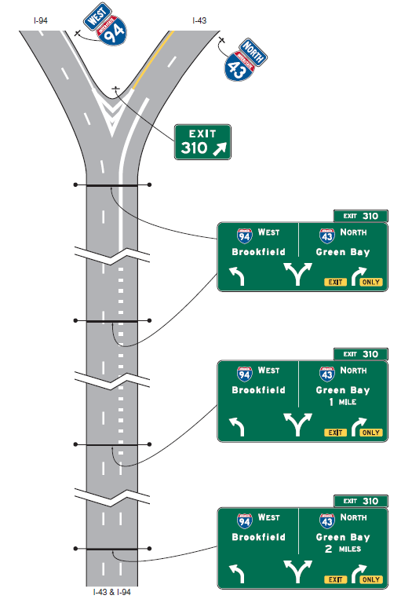
Split with Option Lanes
Remember: APL where Optional Lane present
Notes:
Key Message: Recall APL Signs are where an option lane is present at multilane exits. Hence in this case Diagrammatic Group-APL

Slide 32
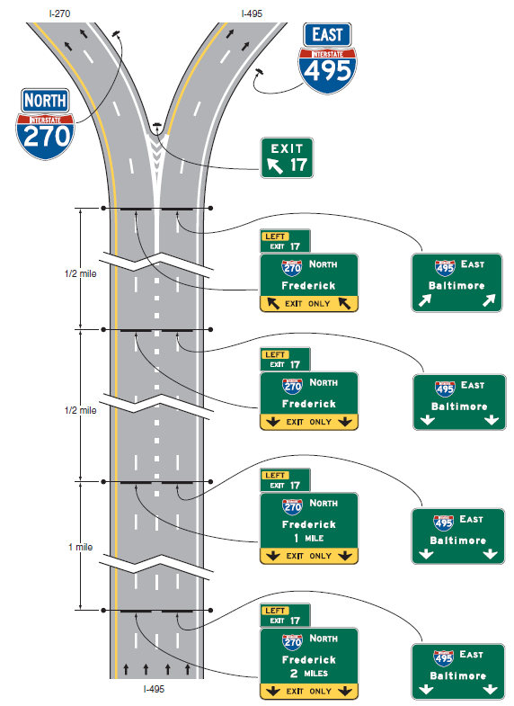
Split with Dedicated Lanes
Remember: Conventional signing where no Optional Lane is present
Notes:
Key Message: No APL sign unless optional lane is present. In the case above where only dedicated lanes exist, Conventional signing Group

Slide 33
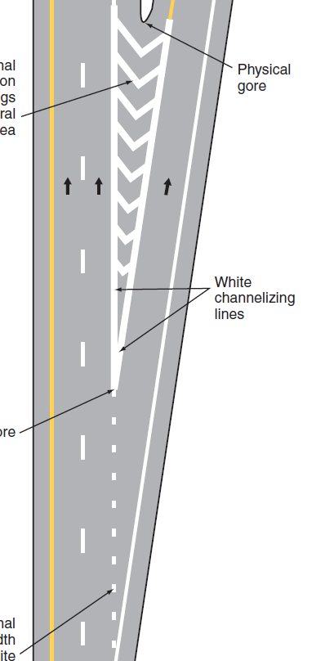
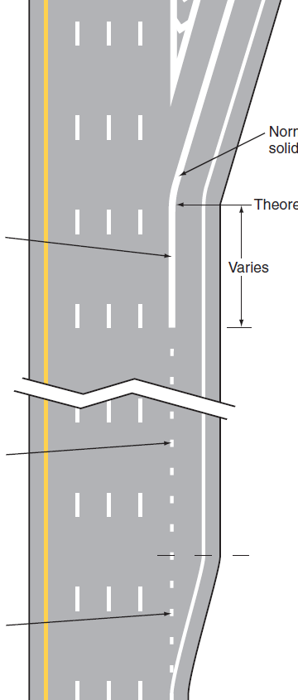
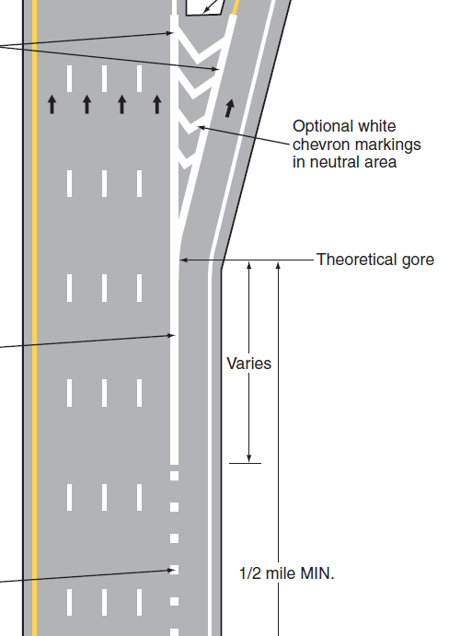
Drop, Auxiliary Decel. & Exit Markings
Parallel w/ option
Drop
Tapered
Notes:
Key Message: Figures from MUTCD. Note that all these use one of more of the three types: dotted, drop, solid. See Fig 3B-10.
NO Broken white any longer for any type of exit configuration. The only exception might be an auxiliary lane developed to the right of a drop lane (which MUTCD does not address). For the short aux. lane a broken line might be provided; the drop marking would be adjacent to it (denoting this lane has been dropped and any lane developed off of it is dropped as well.)
Suggested Comments: The MUTCD, as pointed out with signs, does not cover every conceivable scenario.
Suggested Questions: Is your agency’s stds. In accordance with this? Does your agency have an exception to these standards?
Additional Information:

Slide 34
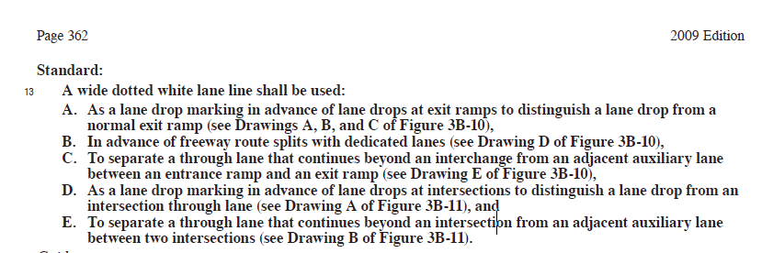
Wide Dotted Lane Lines

Slide 35
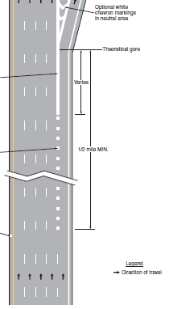
Dropped Lane
“…a through lane that becomes a mandatory exit lane on a freeway or expressway.”
MUTCD partial Fig 3B-10, Dwg A
Notes:
Key Message: Important to distinguish between a drop and a reduction. DROP= TURN or EXIT; REDUCTION=MERGE.
Suggested Comments: Later we’ll see the use of this term is not consistent in other manuals and guidelines
Suggested Questions:
Additional Information: See MUTCD 3B.04, Paragraph 13 C page 362. for the auxiliary lane considered and marked as a lane drop. If 2 miles or less, it must be marked with a dotted white line (Standard) 3B.04, paragraph 6, page 356.

Slide 36
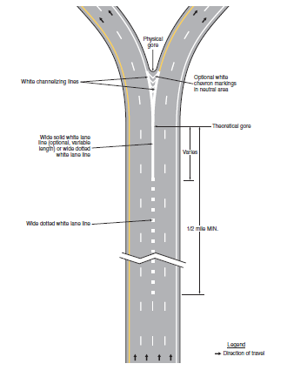
In advance of freeway splits…

Slide 37
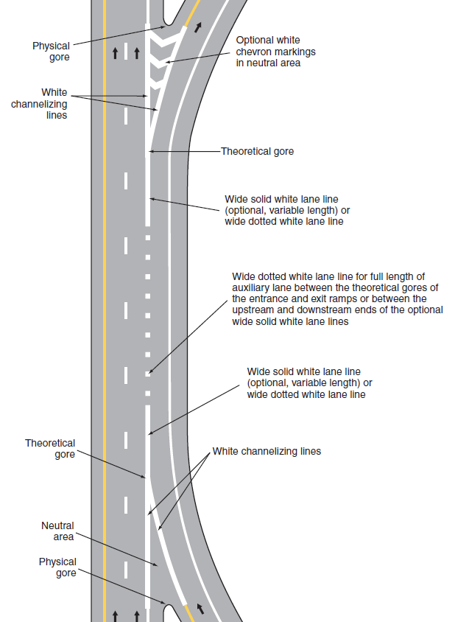
Lane Drop Marking
An auxiliary lane added at one interchange and terminated with a drop at a nearby interchange is also considered a dropped lane for marking purposes
See Fig 3B-10 E.
Notes:
Key Message: MUTCD says to mark an auxiliary lane from a thru lane in the same way as a drop lane if 2 mi or less between interchanges. So lane drop marking are for use at dropped lanes and some auxiliary lanes (between closely space interchanges)
Suggested Questions:
Additional Information: See MUTCD 3B.04, Paragraph 13. C page 356.

Slide 38
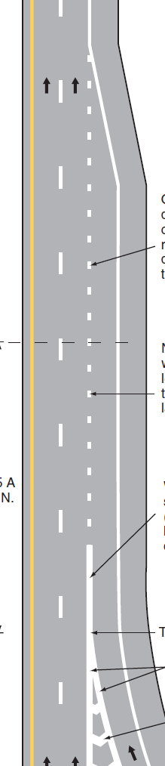
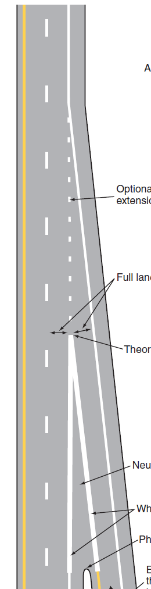
Entrance Ramp Markings
Fig 3B-9 A&B
Channelizing lines may be shortened
Parallel
Tapered
Notes:
Key Message: Note that both types of entrance ramps now use the dotted white lane line. This denotes the fact that the lane is transitioning or ending. Motorists who come down a freeway or expressway entrance ramp anticipate the need to merge. If the lane is too long or is an added lane this can cause some additional driver load to determine the extent of the lane. An added lane would be marked with a broken lane line. In a later module we’ll discuss what constitutes or best distinguishes to the driver an added lane vs. an accel lane.
Suggested Comments: Note that the dotted line may be discontinued at the ½ distance of full width parallel accel lane. The dotted line on the tapered accel lane is optional. ANIMATION NOTE: The channelizing line on the tapered accel lane may be shorten to the point where a 6 ft. separation exists between the two lines
Suggested Questions:
Additional Information:

Slide 39
NHI Course 380118
Signing and Markings for Complex Freeway Interchanges

